Slide 1

Software Development & Best Practices
Lecture 1 – purpose and apparatus

Slide 2

Purpose

Slide 3

Purpose – The problem is data
The rate that data is being created on the internet is nothing short of incredible. In 2017 it was estimated to be 463,000,000,000 GB/day.
A significant amount of that data is PII – Personally Identifying Information
We convince ourselves that this is limited to data produced when we provide it to different services on the internet.
However, we are producing data RIGHT NOW. Don’t believe me? Try going here: https://clickclickclick.click/
Ok sure, that’s data but does it really identify me personally?
Actually. Yes. Take a look at: https://coveryourtracks.eff.org/
What this website is demonstrating is browser fingerprinting. Taking all the data from your browser and creating a single hash value from it. This value can be collected by any website and even shared by related sites. Along with any habits or information you generate on the site itself.

Slide 4
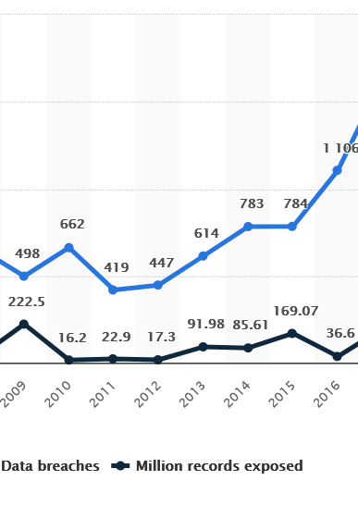
Purpose – data breaches are common
A data breach is any unintentional release of sensitive data.
Over a hundred million records are exposed each year.
Based on Cyber-Insurance claims. AIG in 2019 determined that about 14% of all claims were breaches by hackers and another 14% were breaches simply due to employee negligence

Slide 5

Purpose – Software Needs to be audited
A Key feature in this is properly building out our security architecture.
In this program you should already have completed courses detailing the physical and network aspects to security.
We will now move on to handling how to secure software. This includes both how secure software is built AND how to test for common security problems in software.

Slide 6
Do I need to know how to code?
No, but by the time you finish this course you should…
Have a clear understanding of the kinds of web application architectures that exist.
Have a reasonable handle on how to develop a simple web application in PHP. If you are already familiar with PHP or web application development, we won’t be spending too much time on this.
Be familiar with how to examine an existing application for common security flaws both by examination of its behavior and to some degree by looking at its code.

Slide 7

Evaluation

Slide 8
evaluation
Lab 0 (1%) – This is a simple exercise due by our next lecture which simply demonstrates that you were able to set up the LAMP environment correctly. It’s explained later in this slide deck.
Quizzes (35%) - We will have five quizzes. Staring in week two you will have one every week in class. The quizzes will cover the material from the previous weeks lecture. You will be given time in class to do the quiz, the quiz can be attempted multiple times (up to 10) -- only your highest mark will be kept. If you miss a quiz, it can be made up during the final class.
Labs (32%) – You will be given a VM containing a web application and a goal. You will attempt to achieve that using the techniques taught in this course while keeping careful notes. These notes are what you will hand in.
Final Exam (32%) – There’s no mid-term for this course but there is a comprehensive final exam. It will be about 30 multiple-choice questions.

Slide 9
Apparatus

Slide 10
Our tools
We will be building and examining web applications using the TURNKEY Linux LAMP system.
LAMP – Operating System (Linux), Web Server (Apache), Database (MySQL) and Programming Language (PHP)
The Linux systems we will be examining will be running on a Virtual Machine on Oracle’s VirtualBox platform.

Slide 11
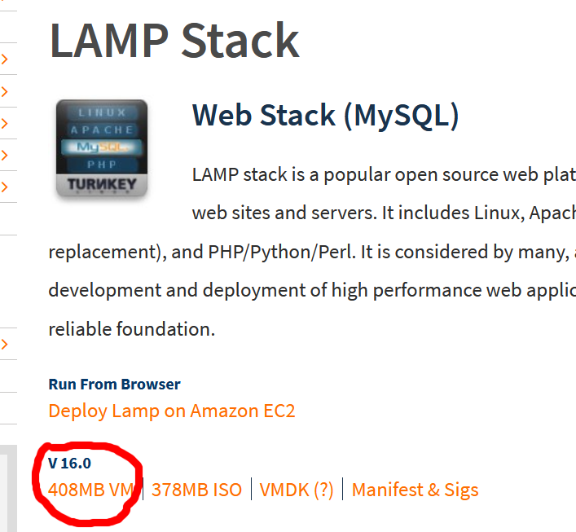
LAB 0
Step 1: Download and install the current version of virtualbox: https://www.virtualbox.org/ or use the one from mohawk apps: https://apps.mohawkcollege.ca
Step 2: Download the TurnKey Linux LAMP VM ova image from Canvas

Slide 12
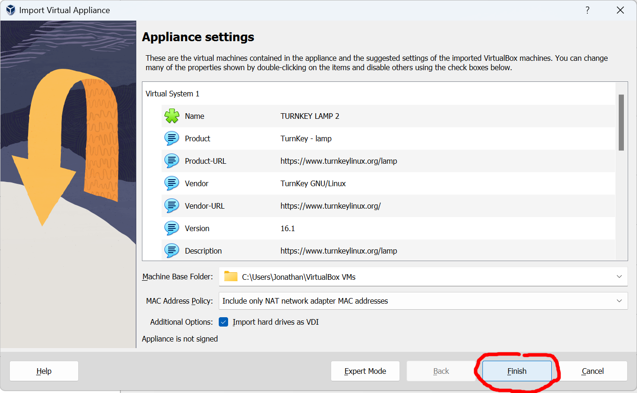
LAB 0
Step 3: Open the VM using VirtualBox (usually just double-click on it) and click ‘finish’ (or ‘import’ if you’re using an older version)

Slide 13
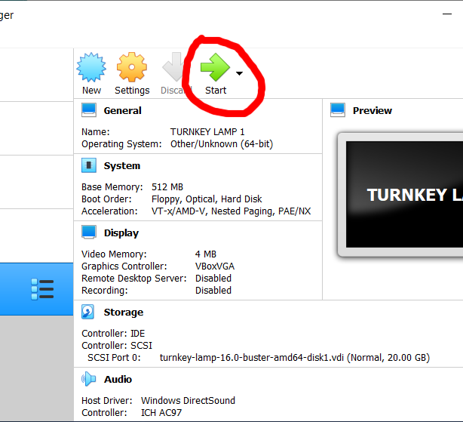
LAB 0
Step 4: The machine you just imported should be selected. Just click “Start” to begin.

Slide 14
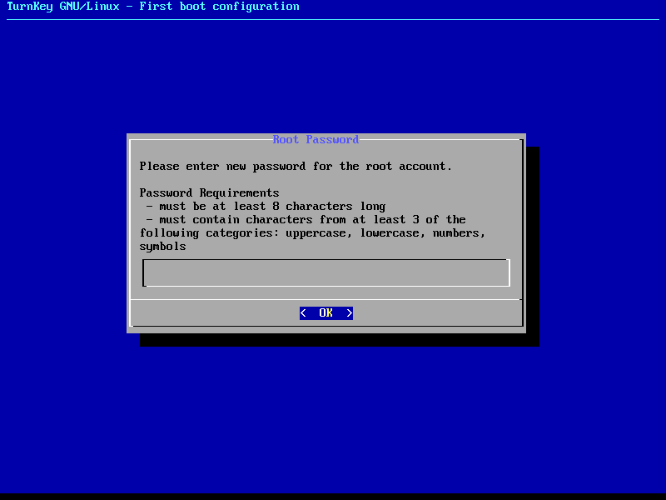
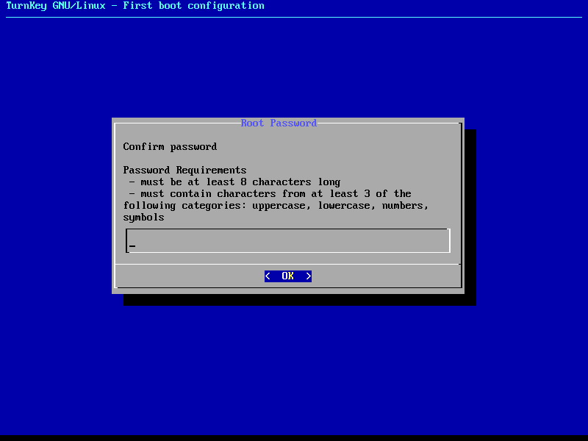
LAB 0
Step 5: Allow the machine to boot
Step 6: Enter a root password when prompted.
Step 7: Enter it again to confirm.

Slide 15
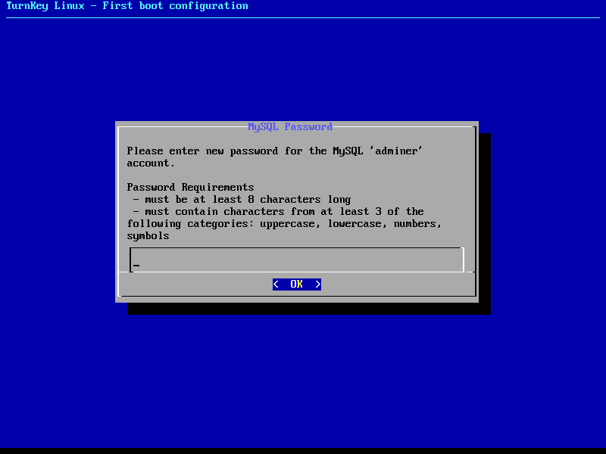

LAB 0
Step 8: Enter a MySQL adminer password (this can be the same as your root password in this case)
Step 9: Enter it again to confirm.

Slide 16
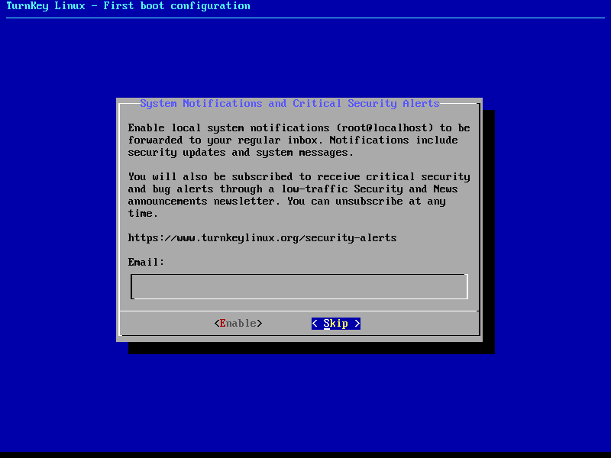
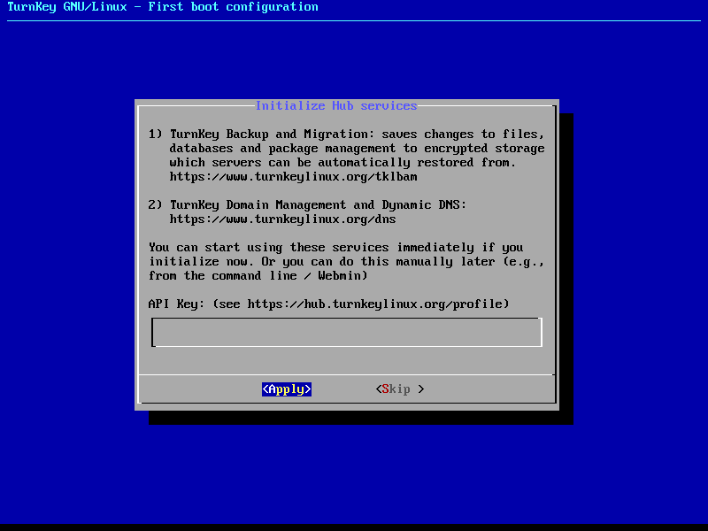
LAB 0
Step 10: When prompted for an API key use the tab key to select “Skip” and hit “Enter”.
Step 11: When prompted for an email address for notifications. Use the tab key to select “Skip” and hit “Enter”

Slide 17
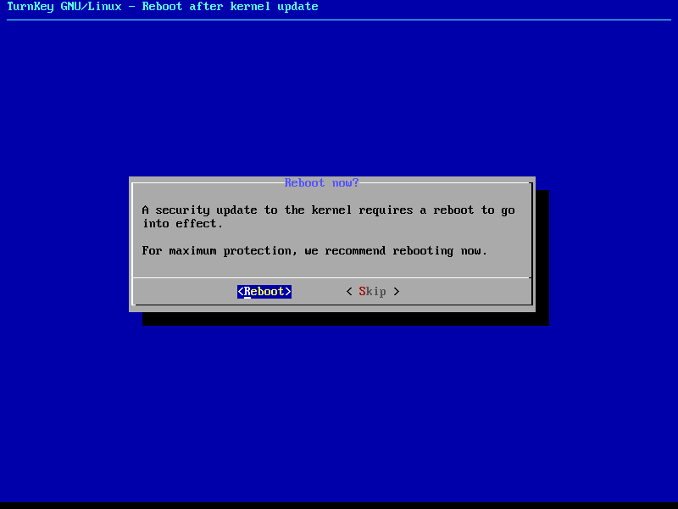
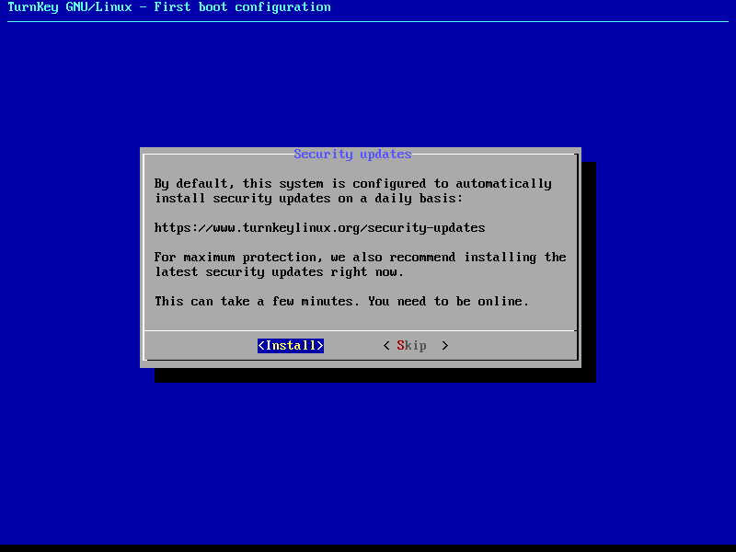
LAB 0
Step 12: When prompted for security updates hit “Enter” to install. This may take some time. (If you have issues installing the security updates. They may be skipped without affecting this lab)
Step 13: If prompted to reboot. Then hit “Enter”

Slide 18
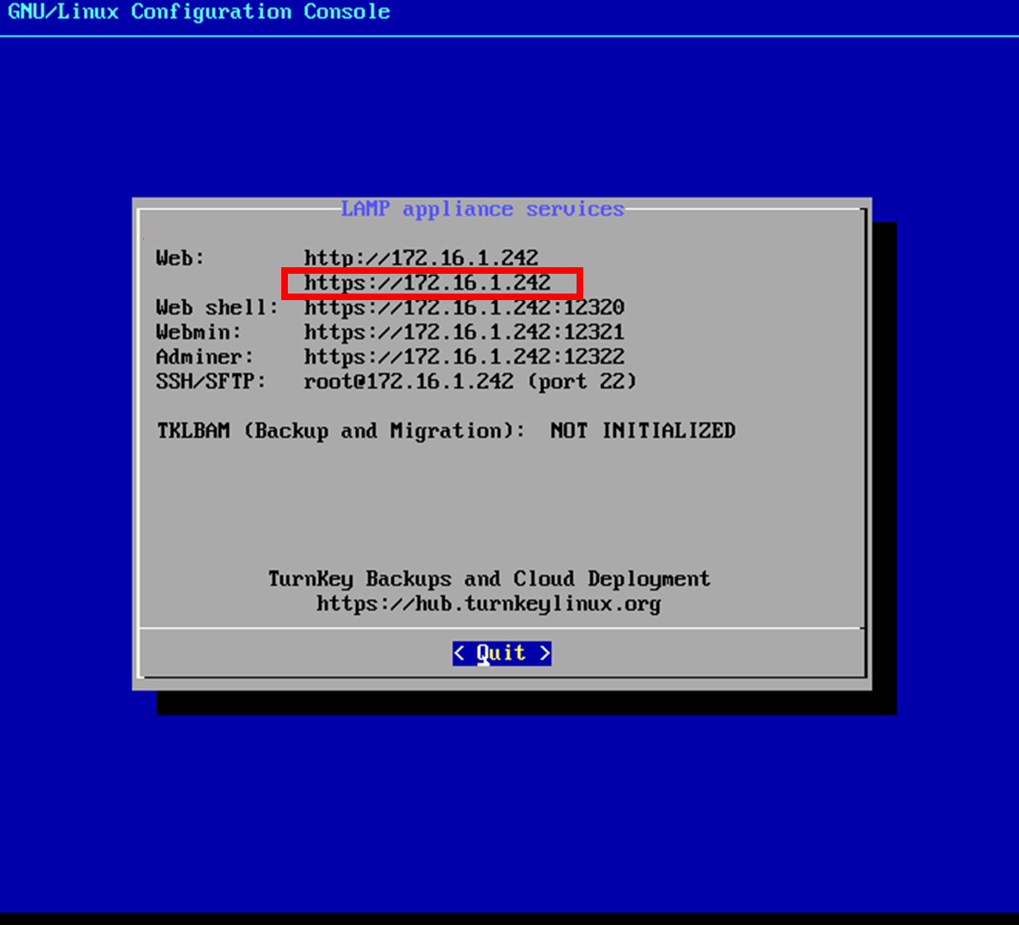
LaB 0
Step 14: Once the VM reboots you will see a screen like this. If the VM does not automatically reboot. Click the close button on the VM window and select “Power off the machine”. The start the machine up again from the Virtual Box window.
Step 15: Open a web browser and point it to the Web URL.

Slide 19
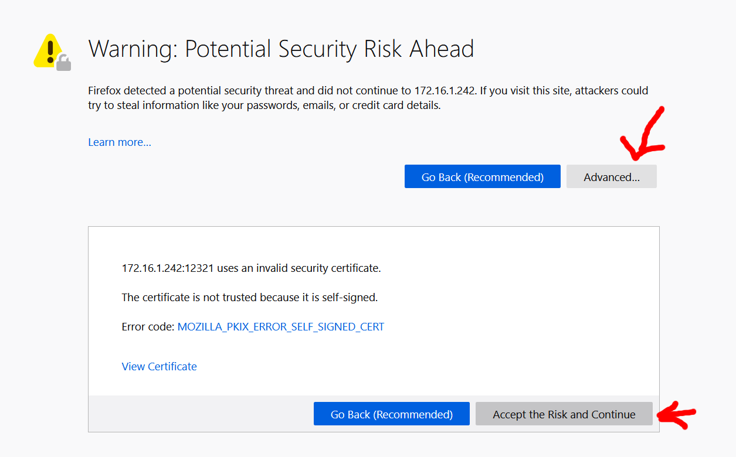
LaB 0
Step 16: You will probably now get a security warning. If you’re using Firefox click on “Advanced” and then “Accept the Risk and Continue”

Slide 20
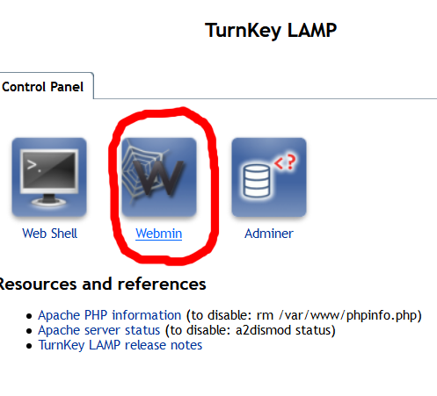
LAB 0
Step 17: You should now be at the main web page. Click on the icon marked “Webmin”

Slide 21
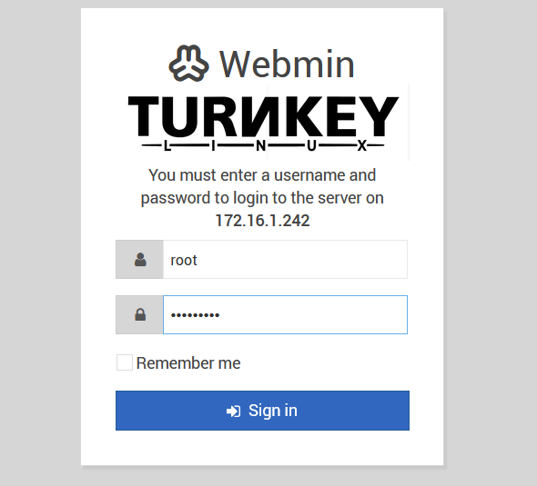
LAB 0
Step 18: You should now be at the login page (if you get another security warning take the same actions as in step 17). Enter Root and the root password you selected in step 6.

Slide 22
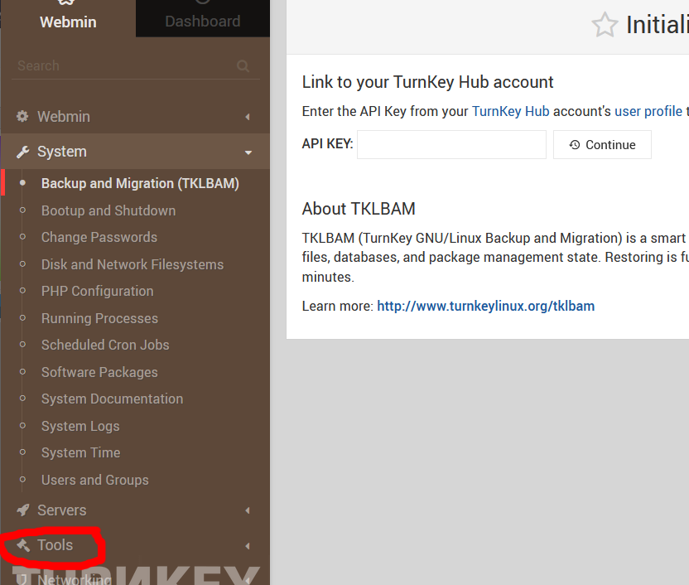
LAB 0
Step 19: You are now at the main webmin console. Select “Tools” from the left-hand menu and then “File Manager”

Slide 23
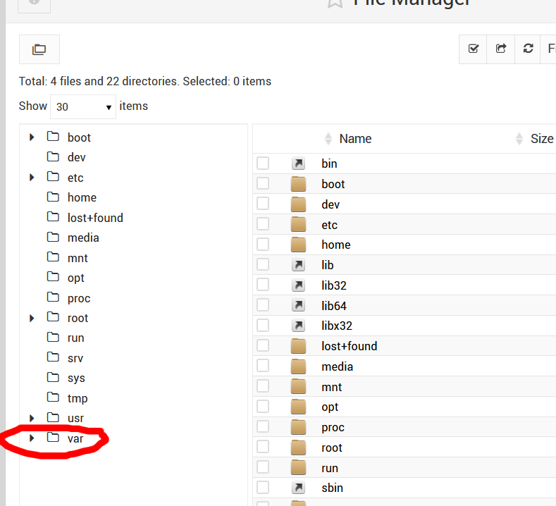
LAB 0
Step 20: Click on the small triangle next to “Var” to enter that directory. Then repeat this for “www”.

Slide 24
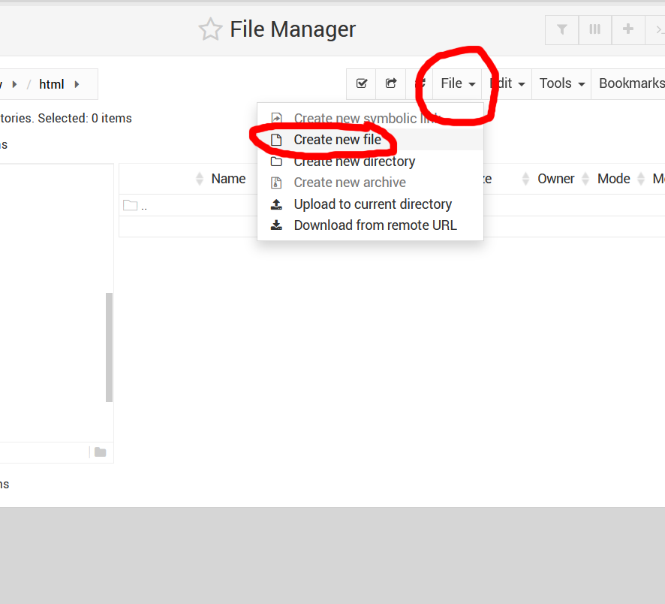
LAB 0
Step 21: Now click on the “File” menu and then select “Create new file”.

Slide 25
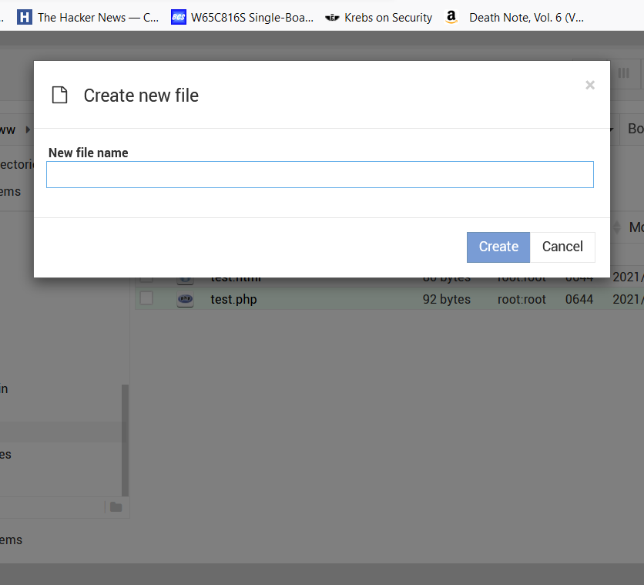
LAB 0
Step 22: You will now be prompted for a filename. Enter “test.html” and then click “Create”

Slide 26
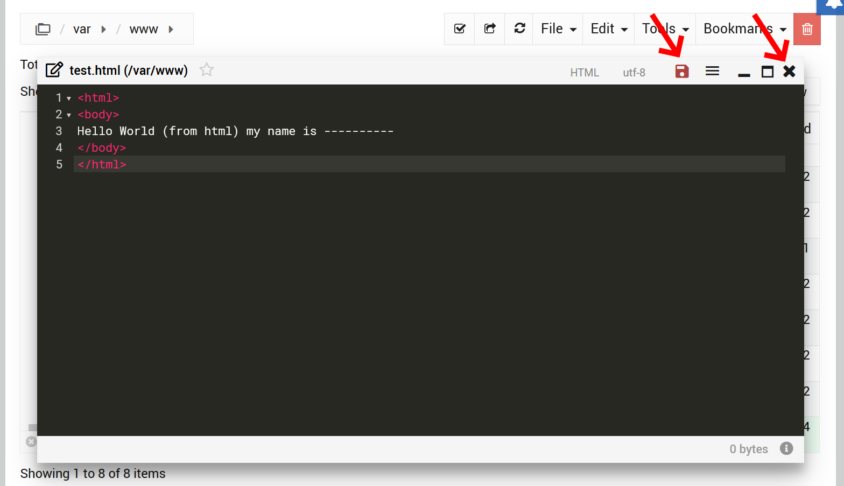
LAB 0
Step 23: A black dialog box will now appear that you can type text into. This is the file editor. Type the code you see in the picture to the left. Replace “----------” (the series of dashes) with your own name.
Step 24: Click on the “disk” icon at the top of the editor window to save the file.
Step 25: Click on the “X” icon at the top of the editor window to close the file.

Slide 27
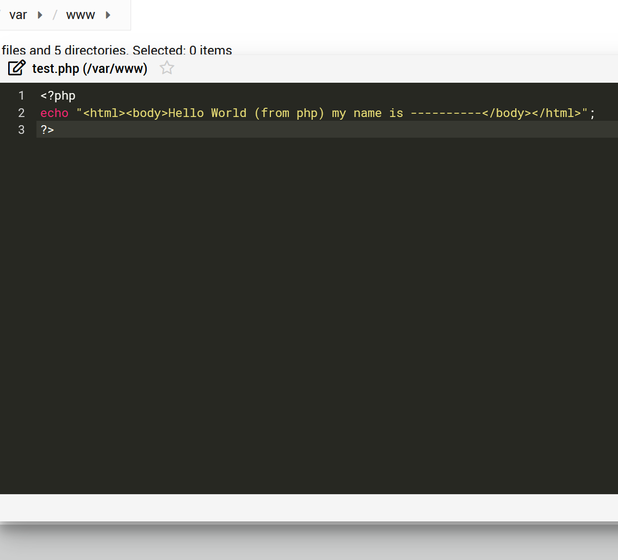
LAB 0
Step 26: Go back to the browser tab with the File Manager and create a new file. This time call it test.php. Enter the code you see in the image on the left. Make sure you replace “----------” with you own name. Save the file and close the window.

Slide 28
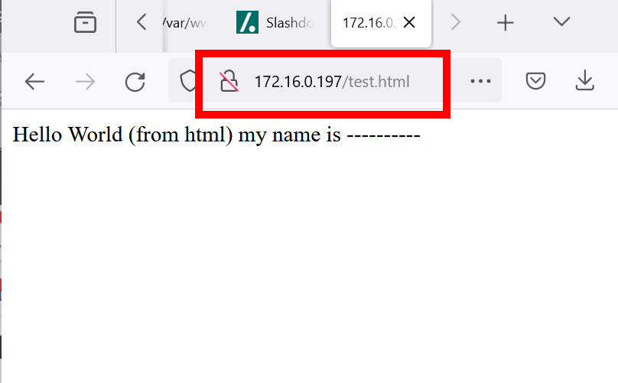
LAB 0
Step 27: Open a new browser tab and point it at the web url but this time add the path “/test.html”. If the result looks like the image on the left (but with your name), then take a screenshot and save it to a file. Do the same for “/test.php”.
Step 31: Upload both of these image files to Canvas in the dropbox marked Lab 0.

